Slide 1
Automation Project Journal
By Oscar Rodgers

Slide 2
Initial Plan (July 29)
Today I received the assignment, to create an automated process with arduino.
My current and first plan is to have a device that automatically notifies me when I have received a new email (From various different email accounts) or even a message on twitter/facebook.
The idea is that when I have an unread email/message there will be a light green light on and an lcd screen telling me I have an email/message. When I read the email/message the light turns off and another red light turns on and the lcd screen says I have no new messages.
An extension that I may apply to this is as a general notification machine, i.e. if there is a particular celebrity or page I follow I can have the device notify when they have posted, this means that the code will need flexibility and modularity, thus the use of libraries. I am currently planning to use an ethernet or internet shield and have a python script do the email scraping for me.

Slide 3
General outline of device
Receive a Message
Python Finds the message
The information is sent to a simple web server
A message is sent to the arduino
Arduino Writes the message to a log file
A buzzer is sounded
The Arduino prints to the LCD
This will be an email or tweet.
Using IMAP and a twitter API key python will regularly check for updates.
Using a python library, an update on the unread emails/tweets will be sent to the arduino webserver.
This will be done over the ethernet shield where the arduino retrieves the data off the web server.
This is to assist with debugging and testing but also to demonstrate writing to file
This may not be a buzzer but any physical indicator. Potentially a LED or multiple LED’s.
An LCD screen will print to the user that they have X unread emails and Y unread tweets.

Slide 4
Setting Up the Python (Aug 6)
My first step to my project is getting the python to successfully search my inbox for unread emails. I am going to do this using a library called Internet Mail Access Protocol (IMAP for short).
Setting this up is easy enough, my current challenge is to get it to find unread messages without marking them as read. Then from here I have to get the python to post data to the arduino webserver which I am yet to setup.

Slide 5
Got Python to work (Aug 6)
I have no completed the script which allows me to see how many unread emails are in my email box. As seen in the test log it took many tries, this is because I had many issues:
Python/IMAP would return how many emails are in my inbox, regardless of if they’re read or not. This was fixed by iterating through each email and using a command I found from stack overflow to see if it is unread
Then Python/IMAP would keep returning 0 even though I had an unread email. I noticed that after I ran the script the email in my inbox would be marked as read even though I never clicked in it. I then fixed this by setting IMAP to read only mode, meaning that when it fetched all the unread emails it wouldn’t open them as to leave it unread.
My Primary source for this was the following link in addition to IMAP documentation: https://stackoverflow.com/questions/13210737/get-only-new-emails-imaplib-and-python

Slide 6
Progress Update:
Completed:
Python Scraper
To be completed:
Python to Arduino Webserver (In progress)
Arduino Write to text file
Write Library
Create UML Diagrams and Fritzing Diagram
Output and user interaction
Twitter (extension)

Slide 7
Creating The library
While I cannot setup a webserver at school I will focus on making my library which will make a class that will take the data from the webserver and interpret it for the user. At this stage it will involve:
A Boolean to determine if anything needs to be done,
A Integer to show how many unread emails there are,
Various char’s to store data about the email (sender, time, etc) to store on log

Slide 8
Starting Arduino Code (Aug 13)
I am currently starting by trying to set up the arduino with the ethernet shield so that I can have a web server running on the arduino where I can send the data collected by python.
To do this I am using the Arduino tutorial on setting up an arduino webserver:
https://www.arduino.cc/en/Tutorial/WebServer

Slide 9
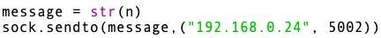
Now using UDP (August 16)
Following research, I found a MUCH easier way to send data from python to arduino: User Datagram Protocol (UDP). This is much easier to implement as the Ethernet shield I am using is compatible with UDP receiving and sending.
To implement UDP into my python was very simple. I has to use a common library socket which interacts with the various ports on the computer and is able to read and write over these ports.
Now I can easily take my string for the amount of unread emails I have. The following code does this:
Where the variable n is the integer for how many unread emails I have. Then the sock is a class object for the socket library. The send to function takes the string form of n and sends it to the IP address of the arduino over port 5002. I chose this port because it isn’t a commonly used port and thus is unlikely to be being used by either my computer or the arduino.

Slide 10
Arduino UDP
On the receiving end of the Python message the arduino reads the UDP packet and is able to save the received string.
The other component I got to work was writing to SD card, this was done by following the inbuilt example which is quite simple and writes a line to the datalog.txt file on the microSD situated in the ethernet shield.
This worked without issues.

Slide 11
Class Update (Aug 19)
I finally got around to implementing my library into my arduino code. My issue was is that I was trying to use an object from another class within my library (specifically the lcd object from the lcd library I am using)

Slide 12
SD card logging successful
I have no established the SD card to be written to, now when a new amount of emails is given from Python, two lines will be written to the SD card. The lines look like:
Email count changed to: 3
This many milliseconds after startup: 63341

Slide 13
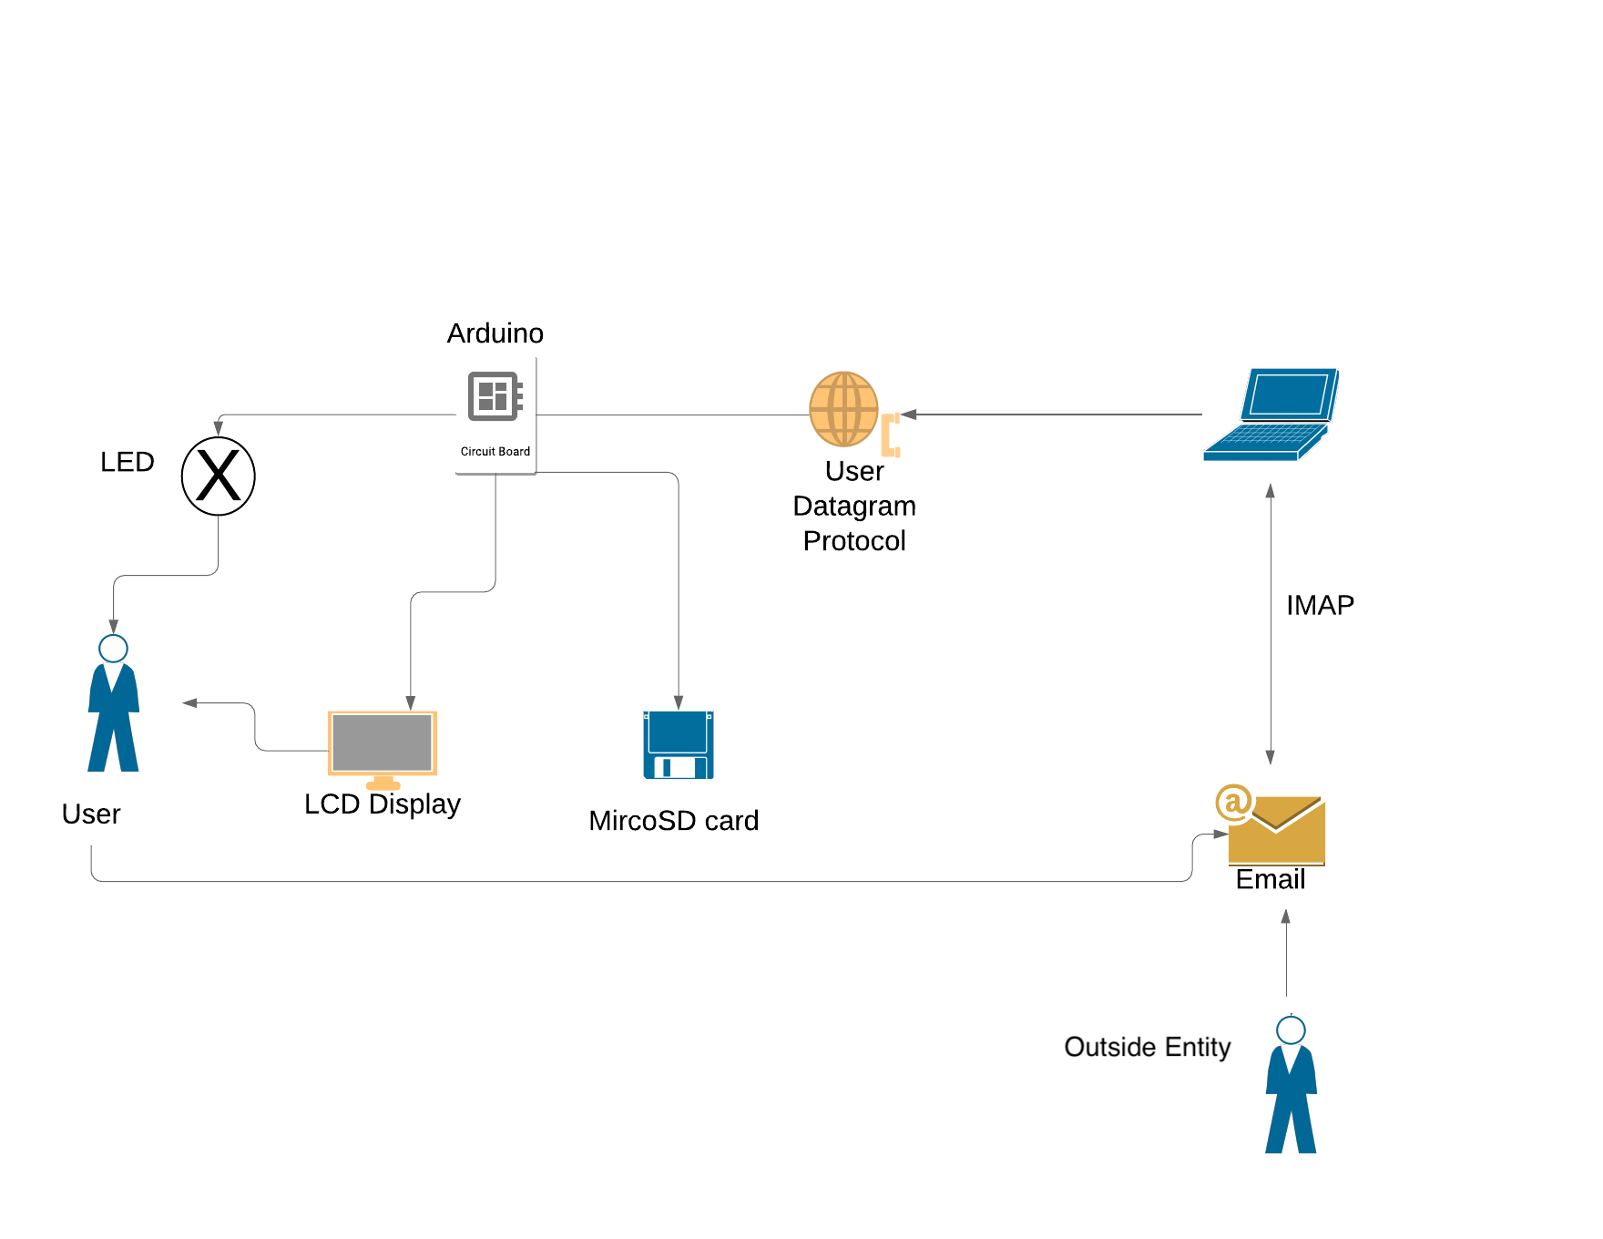

Slide 14
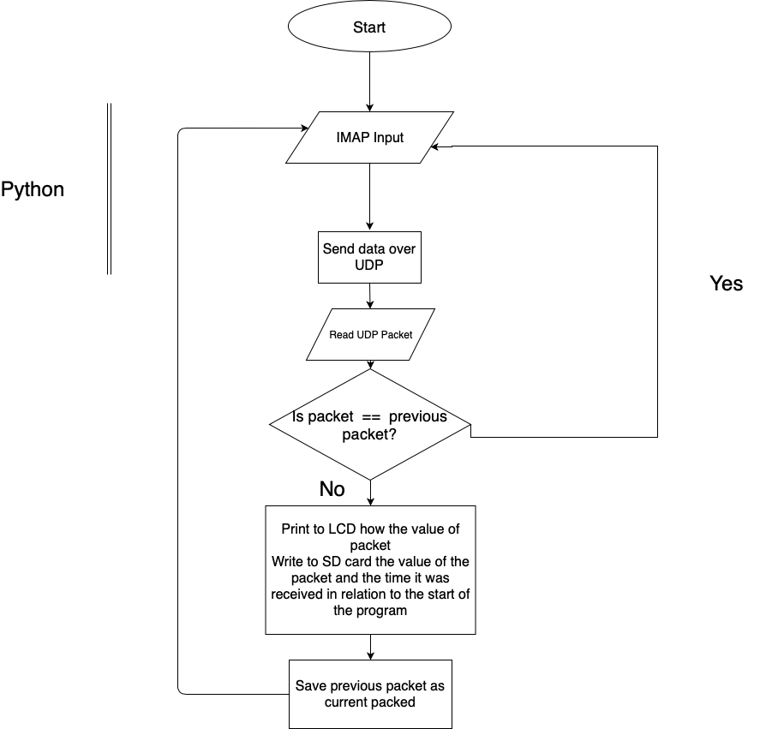

Slide 15
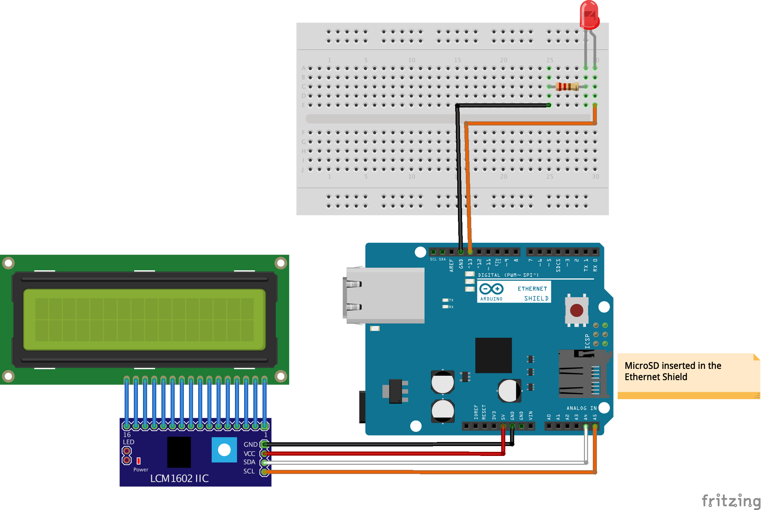
Fritzing

Slide 16
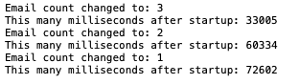
Complete!
The project is now complete. I can now receive an email and be told that I have X emails remaining, I also receive a flash of the LED, although it is hard to see in the video. Additionally the SD card is written to and the log looks like:

Slide 17
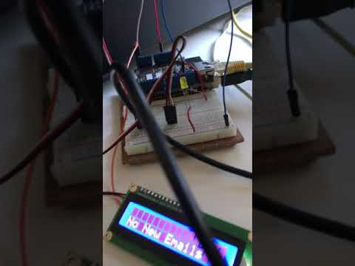

Slide 18
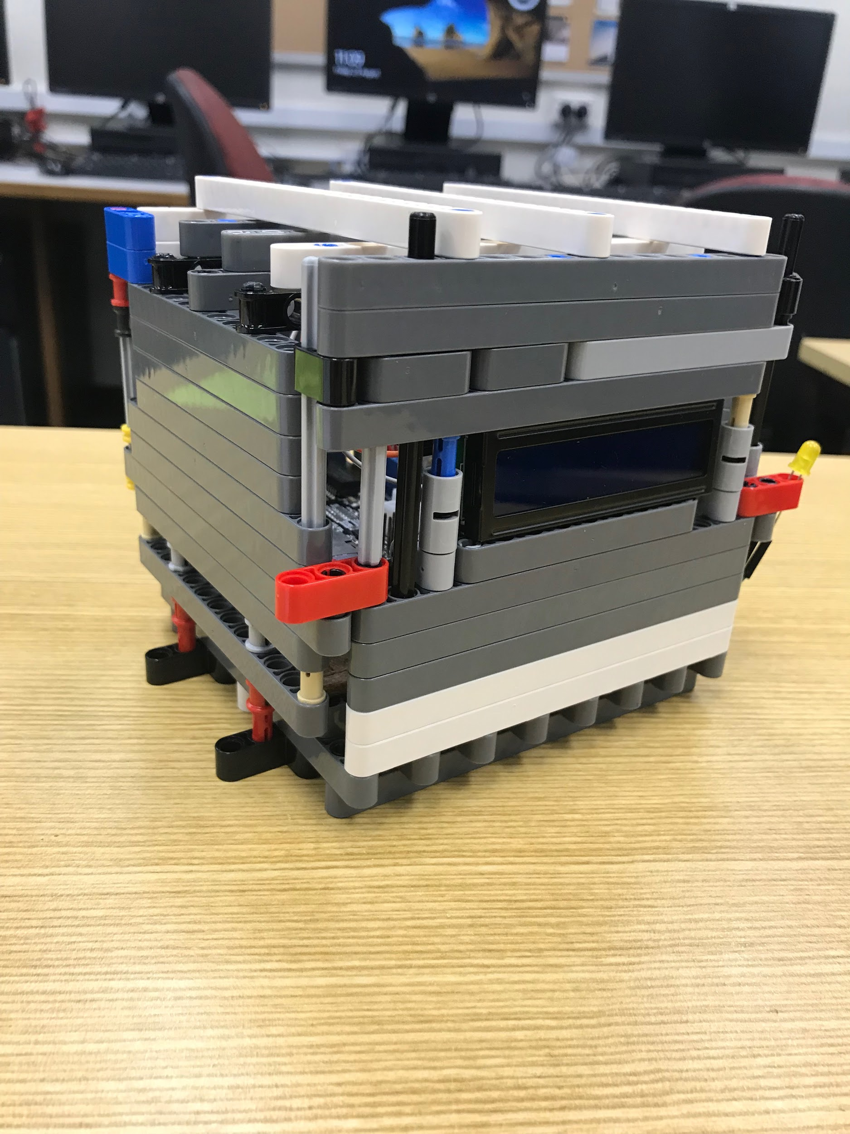
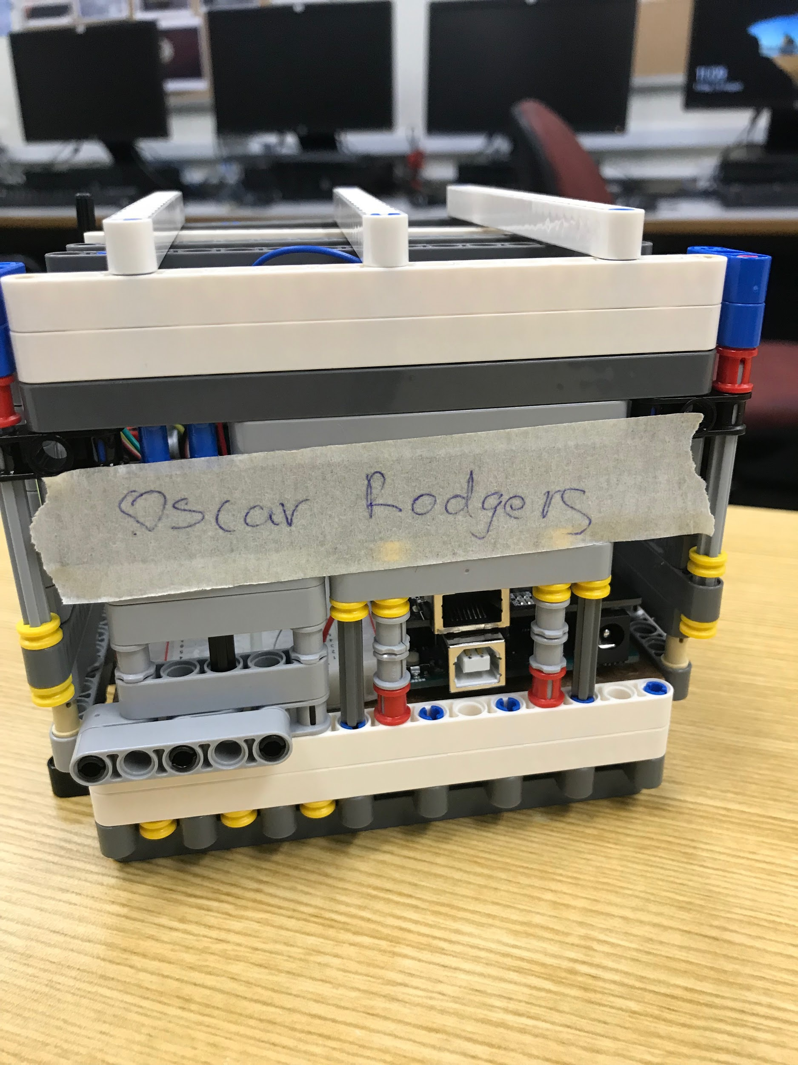
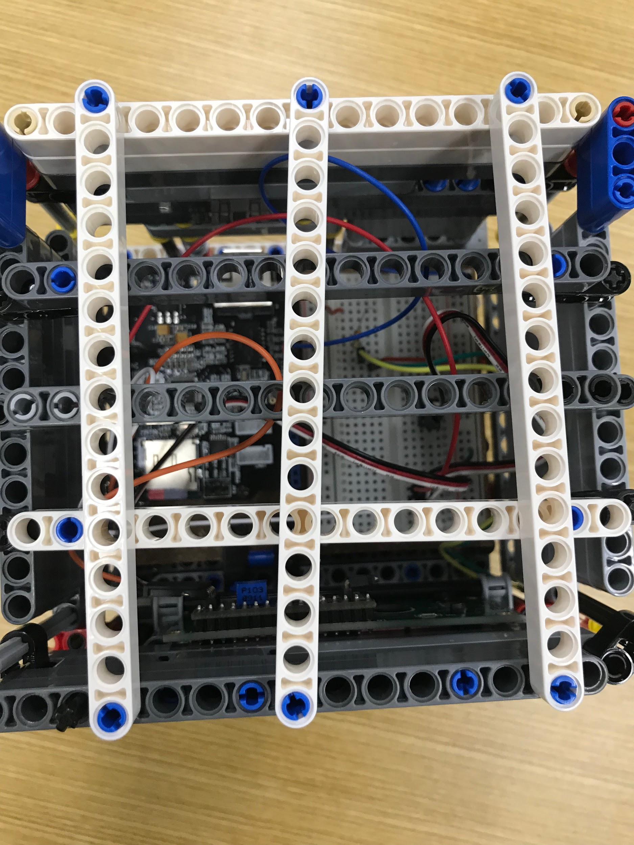
Housing

Slide 19
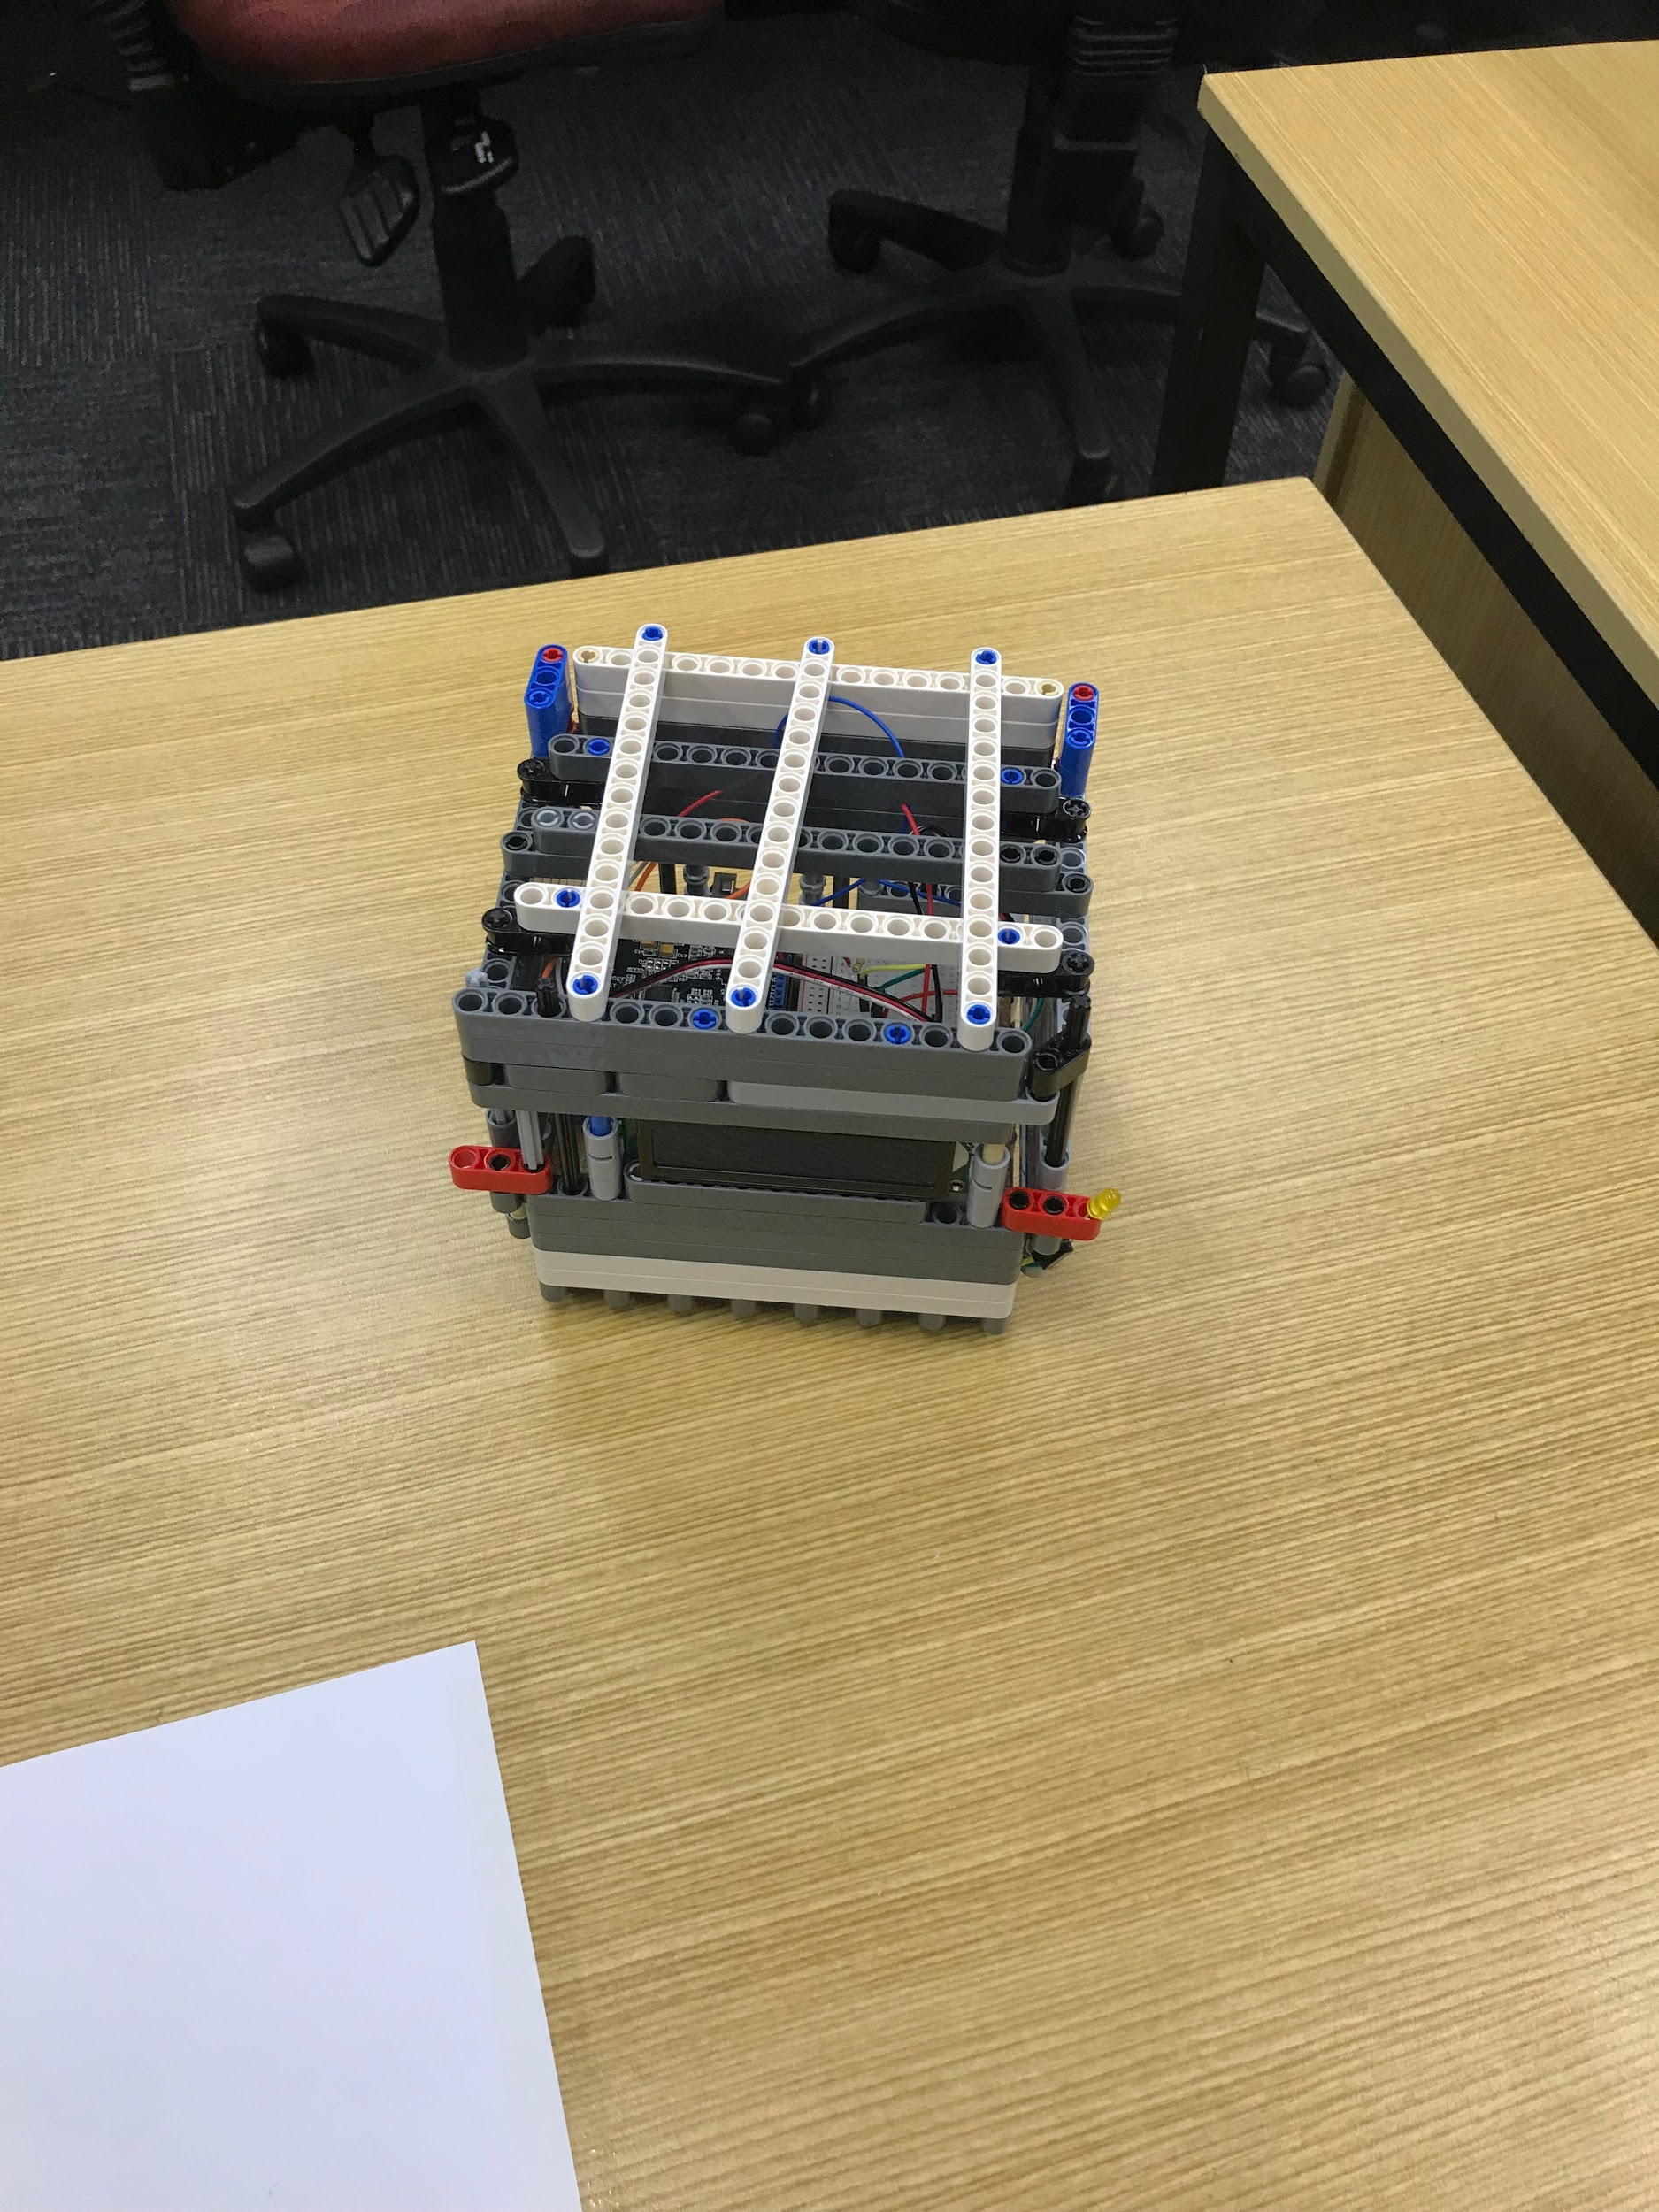
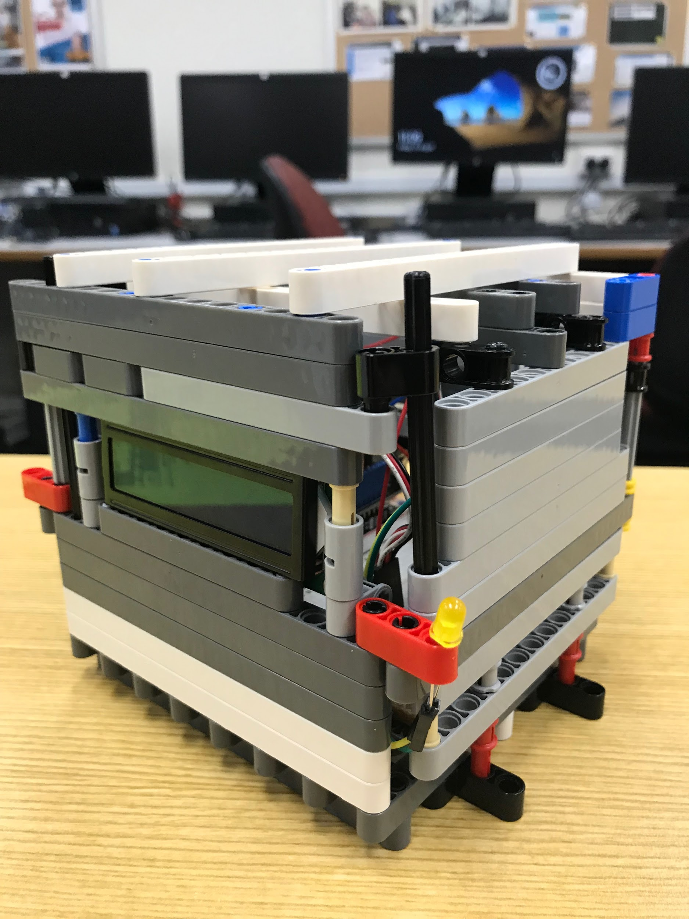

Slide 20
